Slide 1




DIABETES 30-DAY READMISSION PREDICTION
USING TABTRANSFORMER, FEDERATED LEARNING,AND EXPLAINABLE AI
“ THIS PROJECT FOCUSES ON PREDICTING WHETHER A DIABETIC PATIENT WILL BE READMITTED TO THE HOSPITAL WITHIN 30 DAYS, USING AN ACCURATE, PRIVACY-PRESERVING, AND EXPLAINABLE AI MODEL.”

Slide 2



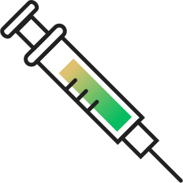
Existing models lack:
Strong feature interaction learning
Privacy preservation across hospitals
Clear explanations for clinical decision-making
This project introduces an AI-based framework that combines:
TabTransformer for advanced tabular data learning
Federated Learning (FedAvg) for privacy-preserving multi-hospital training
Explainable AI (SHAP & LIME) to make predictions transparent and clinically understandable
Objective:
To accurately predict 30-day readmission risk in diabetic patients while ensuring privacy, robustness, and interpretability.
PROBLEM BACKGROUND
Diabetes is a long-term chronic disease that often leads to repeated hospital admissions
30-day hospital readmission is a key indicator of:
Quality of patient care
Effectiveness of treatment and discharge planning
High readmission rates increase:
Hospital workload
Healthcare costs
Patient complications and mortality risk
Electronic Health Records (EHRs) contain rich clinical data, but:
Data is high-dimensional
Mostly categorical
Difficult for traditional machine learning models to handle

Slide 3



RESEARCH GAP
Most existing diabetes readmission prediction studies use:
Logistic Regression
Random Forest
XGBoost
Basic Deep Neural Networks
Key gaps in existing research:
❌ Poor handling of high-cardinality categorical EHR data
❌ Limited modeling of complex feature interactions
❌ Assumption of centralized data availability, which is unrealistic in hospitals
❌ Lack of privacy-preserving learning mechanisms
❌ Models behave like black boxes with no clinical explanations
Recent studies (2024–2025):
Focus on ICU mortality, sepsis, or imaging data
Rarely address diabetes readmission
Almost none combine Transformer + Federated Learning + XAI
Specific gaps identified:
No use of TabTransformer for Diabetes 130-US Hospitals dataset
No realistic multi-hospital federated learning simulation
No integrated use of SHAP (global) + LIME (local) explanations
Limited focus on recall, which is critical in healthcare
Research Gap Addressed in This Work:
A unified, privacy-preserving, interpretable deep-learning framework for diabetes readmission prediction using real-world EHR data.

Slide 4




Problem Statement
Hospital readmission within 30 days is a major challenge in diabetes care:
Increases healthcare costs
Indicates poor discharge planning
Leads to higher patient complications and mortality
Existing challenges in predictiNG READMISSION:
DIABETes EHR data is high-dimensional and highly categorical
Readmission cases are rare (~11%), causing class imbalance
Hospitals cannot share patient data due to privacy laws (HIPAA, GDPR)
Clinicians do not trust black-box AI models
Current systems fail because they:
Miss high-risk patients (low recall)
Require centralized data storage
Provide no explanation for predictions
Are difficULT TO deploy across multiple hospitals
Problem Statement
To design a privacy-preserving, accurate, and interpretable AI system that can predict 30-day hospital readmission in diabetic patients using real-world EHR data, while operating in a multi-hospital federated learning environment and providing clinically meaningful explanations for each prediction.

Slide 5

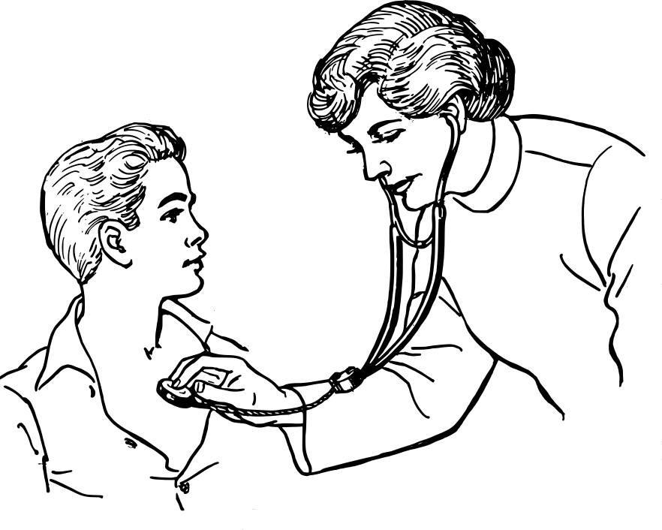

DATA COLLECTION AND DATA TYPE
Data Collection
Dataset used: Diabetes 130-US Hospitals Dataset (1999–2008)
Publicly available, real-world Electronic Health Records (EHR)
Collected from 130 hospitals and integrated delivery networks across the United States
Total patient encounters: 101,766
Each record represents one hospital admission of a diabetic patient
Prediction Target
Original target: readmitted
<30 → Readmitted within 30 days
>30 → Readmitted after 30 days
NO → Not readmitted
Converted into binary classification:
1 → Readmitted within 30 days
0 → Otherwise

Slide 6
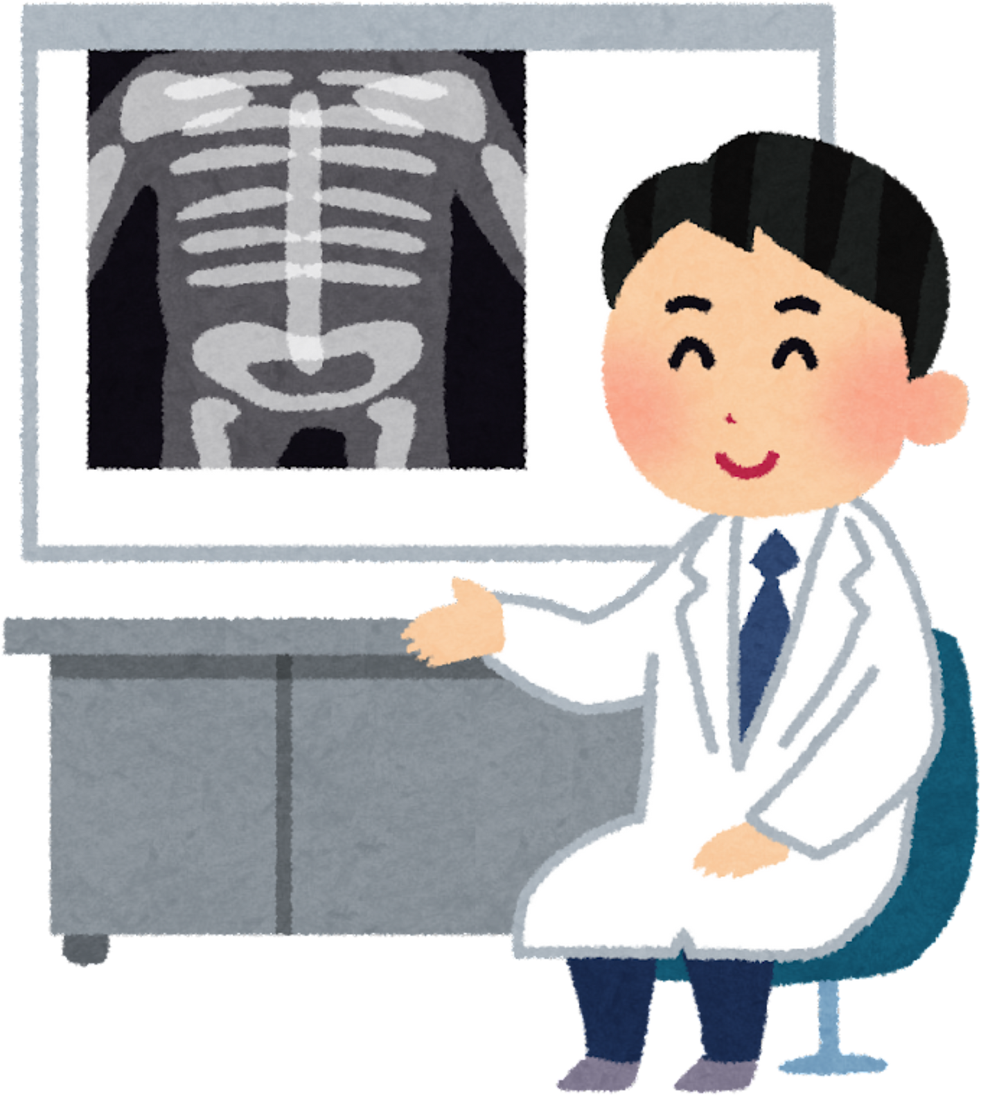


Data Types
Categorical Data (High Cardinality)
Examples:
Race, Gender, Age group
Medical specialty
Diagnosis codes (ICD-9)
Medication change indicators
Numerical Data
Time in hospital
Number of inpatient visits
Number of emergency visits
Number of medications
Dataset Characteristics
Total features used: 46
Highly imbalanced dataset:
~11% readmitted
~89% not readmitted
Contains missing values, reflecting real clinical data
Why this Dataset?
Realistic hospital data
Suitable for deep learning on tabular data
Ideal for federated learning simulation
Widely accepted benchmark for diabetes readmission research

Slide 7




REPORTED ALGORITHMS USED AND ITS ACCURACY
Algorithms Used in Existing Research (Literature Review)
Previous research papers using the same Diabetes 130-US Hospitals dataset have mainly focused on traditional machine learning and basic deep learning models.
Commonly Reported Algorithms
Logistic Regression
Decision Tree
Random Forest
XGBoost
Support Vector Machine (SVM)
Artificial Neural Networks (ANN)
LSTM / RNN (limited use, no true temporal data)

Slide 8

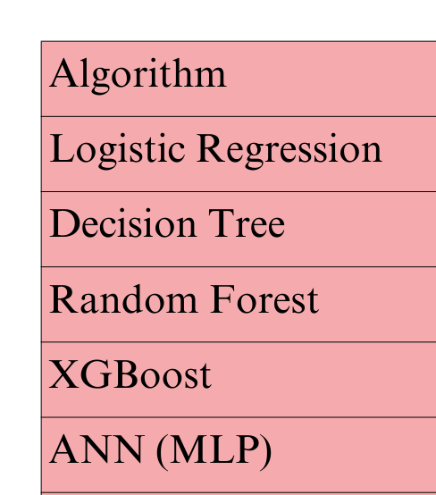


Reported Accuracy in Literature
Key Observations from Literature
Most papers prioritize accuracy only
Limited focus on recall and F1-score
Data is centralized, no privacy consideration
Minimal or no explainability
Same dataset reused, but no architectural innovation
Limitations in Existing Works
High accuracy often hides poor recall
Poor handling of class imbalance
Lack of privacy-preserving methods
Models act as black boxes

Slide 9

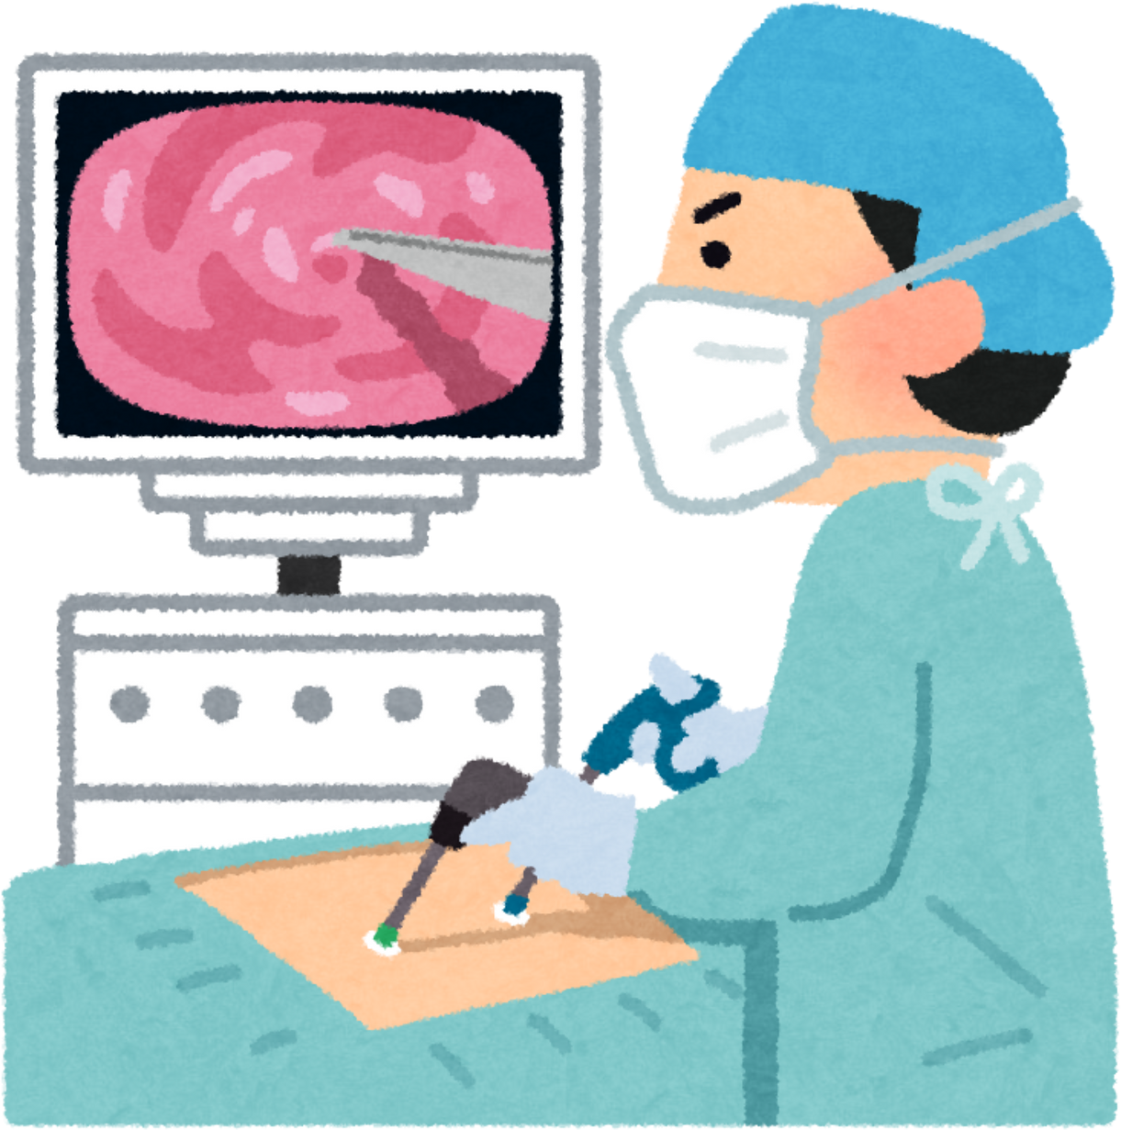
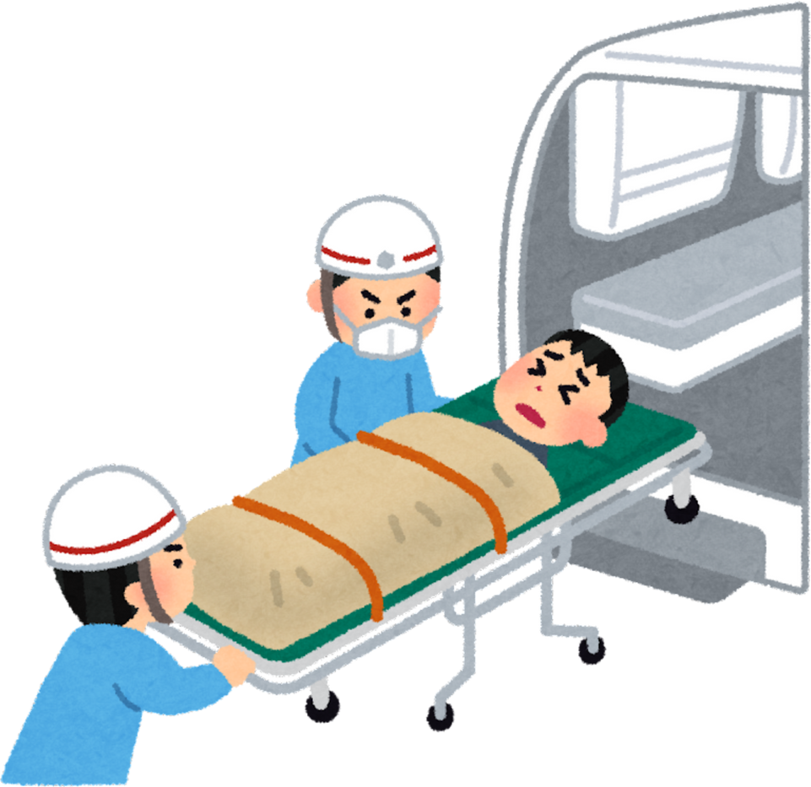

IMPLEMENTATION OF ALGORITHMS USED AND ITS ACCURACY
Algorithms Implemented in This Project
The following algorithms were implemented, trained, and evaluated on the same preprocessed Diabetes 130-US Hospitals dataset to ensure fair comparison.
Implemented Models
Logistic Regression (baseline reference)
Random Forest (baseline reference)
XGBoost (baseline reference)
Centralized TabTransformer
Federated TabTransformer (FedAvg)
Implementation Setup (Common for All Models)
Dataset size: 101,766 records
Train–Validation–Test split: 70% – 15% – 15%
Class imbalance handled using SMOTE (training set only)
Binary classification:
1 → Readmitted within 30 days
0 → Not readmitted
Evaluation metrics: Accuracy, Recall, F1-score, ROC-AUC

Slide 10


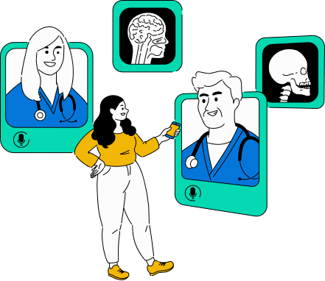
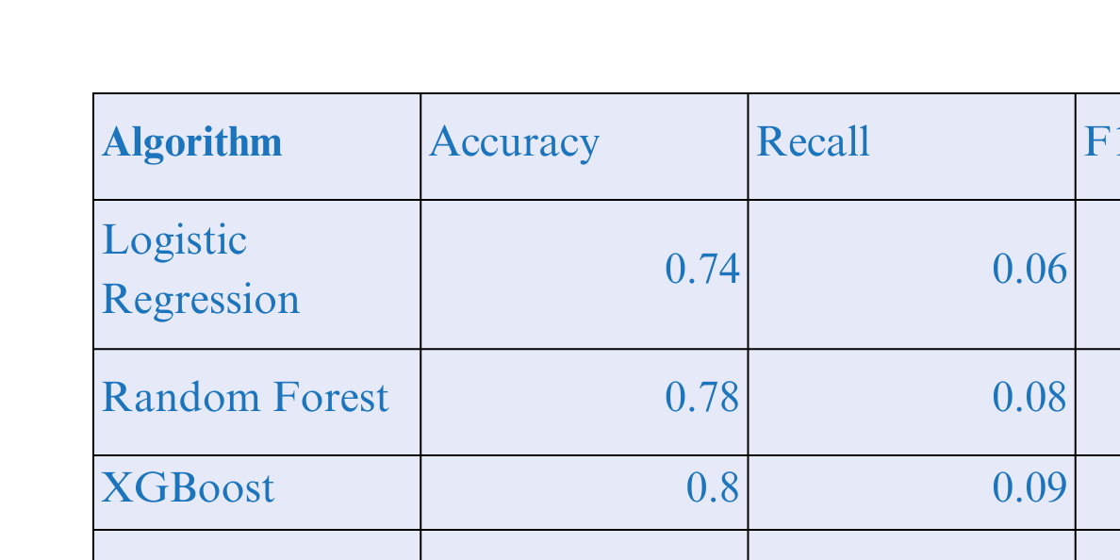


Model Performance

Slide 11





Key Observations
Classical ML models showed low recall, missing many high-risk patients
Centralized TabTransformer improved accuracy but still struggled with recall
Federated TabTransformer achieved the best overall performance
Recall improved by +4.9%, and ROC-AUC by +0.1195 over centralized model
Improvements achieved without sharing raw hospital data
Clinical Significance
Higher recall means fewer missed readmission cases
Federated learning enables privacy-preserving collaboration
Demonstrates real-world feasibility for multi-hospital deployment

Slide 12




FINALIZED ALGORITHMS
Final Algorithm Selected for This Project
After implementing, training, and evaluating multiple machine learning and deep learning models, the Federated TabTransformer using FedAvg was finalized as the optimal solution for 30-day diabetes readmission prediction.
Why Other Algorithms Were Not Finalized
Logistic Regression
Simple and fast
Failed to capture complex feature interactions
Very low recall → missed most high-risk patients
Random Forest
Better than Logistic Regression
Struggled with high-cardinality categorical features
Limited improvement in recall
XGBoost
Strong tree-based model
Better performance than other classical ML models
Still insufficient recall for clinical use
Centralized TabTransformer
Captured complex feature interactions
Improved accuracy
Privacy issue due to centralized data requirement
Lower recall compared to federated version

Slide 13




Finalized Model
Federated TabTransformer with FedAvg
Final Model Architecture
TabTransformer
Categorical feature embeddings
Multi-head self-attention
Transformer encoder layers
Federated Learning (FedAvg)
5 simulated hospital clients
Local training at each hospital
Secure weight aggregation
Explainable AI
SHAP for global explanations
LIME for patient-level explanations
Why Federated TabTransformer Was Finalized
Achieved highest recall and F1-score
Improved ROC-AUC significantly
Preserves patient privacy
Handles real-world hospital data heterogeneity
Provides clinically interpretable explanations
Final Decision Justification
“The Federated TabTransformer offers the best balance between prediction accuracy, clinical sensitivity, privacy preservation, and interpretability, making it suitable for real-world healthcare deployment.”

Slide 14


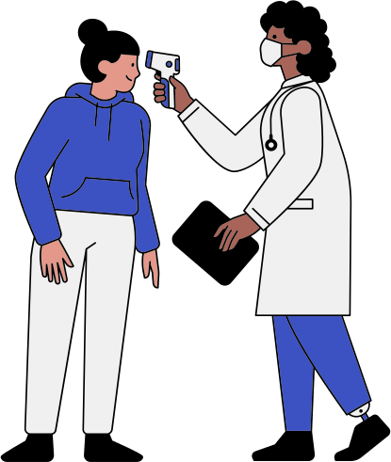

ACCURACY
Model Performance Evaluation
The performance of the finalized model is evaluated using clinically meaningful metrics. Since the dataset is highly imbalanced, accuracy alone is not sufficient. Greater emphasis is placed on Recall, F1-score, and ROC-AUC.
Baseline (Centralized TabTransformer) Performance
Accuracy: 85.82%
Precision: 0.22
Recall: 0.1033
F1-Score: 0.1398
ROC-AUC: 0.6482
Observation:
High accuracy is misleading due to class imbalance
Low recall → many high-risk patients are missed
Not suitable for clinical deployment alone

Slide 15
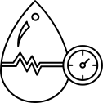
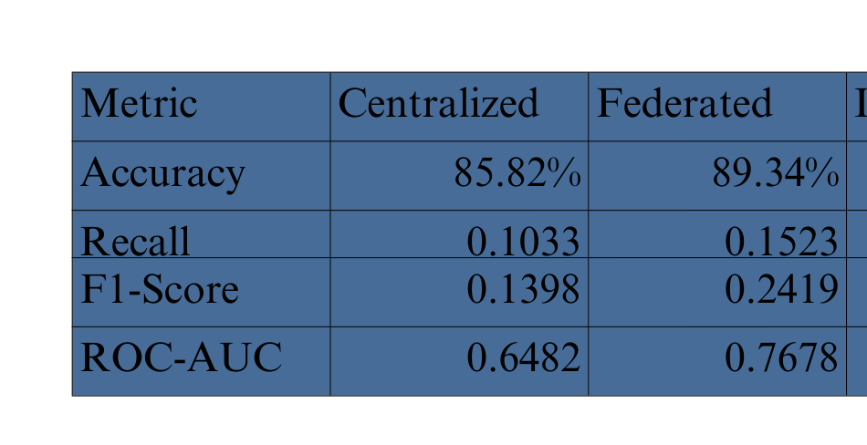

Final Model (Federated TabTransformer – FedAvg) Performance
Accuracy: 89.34%
Precision: Improved
Recall: 0.1523
F1-Score: 0.2419
ROC-AUC: 0.7678
Observation:
Significant improvement in recall and F1-score
Better identification of high-risk patients
Strong improvement in ROC-AUC shows better discrimination ability
Performance Improvement Summary
Clinical Significance
Higher recall = fewer missed high-risk patients
Higher ROC-AUC = better risk separation
Federated model is safer and more reliable for hospitals
Conclusion:
The Federated TabTransformer achieves better clinical accuracy, not just numerical accuracy.

Slide 16




MODIFICATIONS
Key Modifications Introduced in This Project
To improve predictive performance, privacy, and clinical usability, several important modifications were applied compared to traditional approaches.
1. From Classical ML to Transformer-Based Modeling
Before
Logistic Regression
Random Forest
XGBoost
Shallow Neural Networks
Modification
Replaced with TabTransformer
Why?
Handles high-cardinality categorical features
Learns complex feature interactions
Captures non-linear relationships in EHR data
2. Centralized Learning → Federated Learning (FedAvg)
Before
All hospital data combined in one location
Privacy risk and unrealistic deployment
Modification
Introduced Federated Learning with FedAvg
Simulated 5 hospital clients
Benefits
No raw data sharing
Privacy-preserving training
Better generalization across hospitals

Slide 17
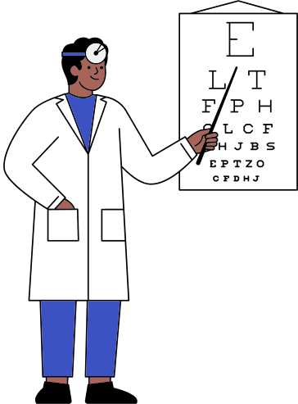

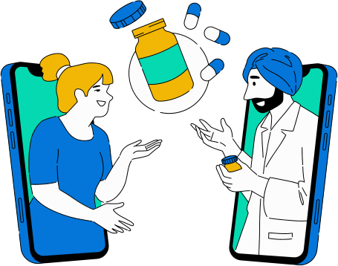

5. Explainability Integration (XAI)
Before
Black-box predictions
Modification
Integrated SHAP (global explanation)
Integrated LIME (local explanation)
Benefits
Clinically interpretable predictions
Increased trust in AI decisions
Patient-level justification
6. Evaluation Strategy Enhancement
Before
Accuracy-focused evaluation
Modification
Emphasis on:
Recall
F1-score
ROC-AUC
Reason
Missing a high-risk patient is costlier than false alarms
3. Handling Severe Class Imbalance
Problem
Only 11.16% patients readmitted within 30 days
Modification
Applied SMOTE on training data
Impact
Improved recall and F1-score
Reduced bias toward majority class
4. Feature Representation Improvements
Before
One-hot encoding (high dimensional, sparse)
Modification
Embedding-based representation for categorical features
Benefits
Compact representation
Semantic similarity learning
Better convergence

Slide 18







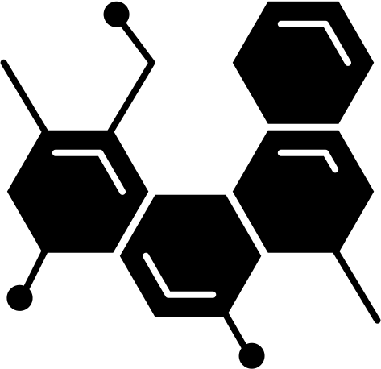
Overall Impact of Modifications
Improved clinical reliability
Better privacy protection
More explainable predictions
Realistic multi-hospital simulation

Slide 19

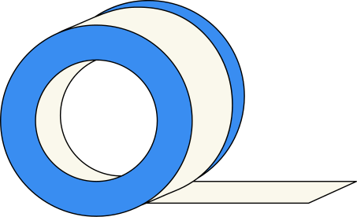
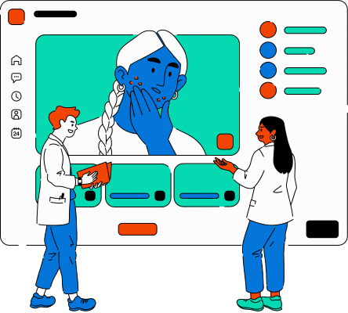
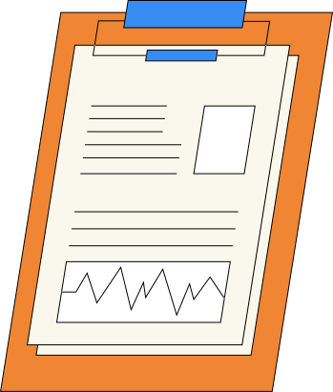
FUTURE WORK
Planned Enhancements and Extensions
Although the current system shows strong performance, several clear improvement directions are identified for the next phase of work.
1. Temporal & Sequential Data Integration
Current Limitation
Dataset is static (no time-series records)
Future Plan
Include:
Medication change timelines
Lab value trends (HbA1c, glucose)
Multiple visit history per patient
Possible Models
Temporal Transformers
LSTM / GRU hybrid models
Expected Benefit
Earlier and more accurate readmission prediction
2. Advanced Federated Learning Techniques
Current
FedAvg (basic aggregation)
Future Enhancements
FedProx → handles non-IID hospital data
Personalized FL → hospital-specific tuning
Secure aggregation → stronger privacy
Benefit
Better performance per hospital
Stronger privacy guarantees

Slide 20

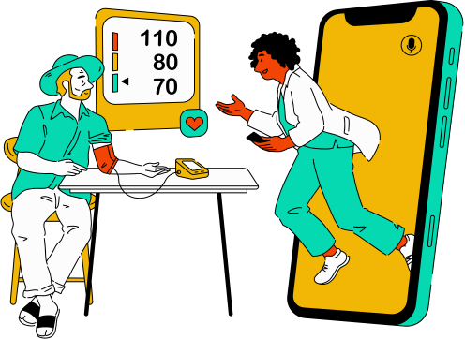
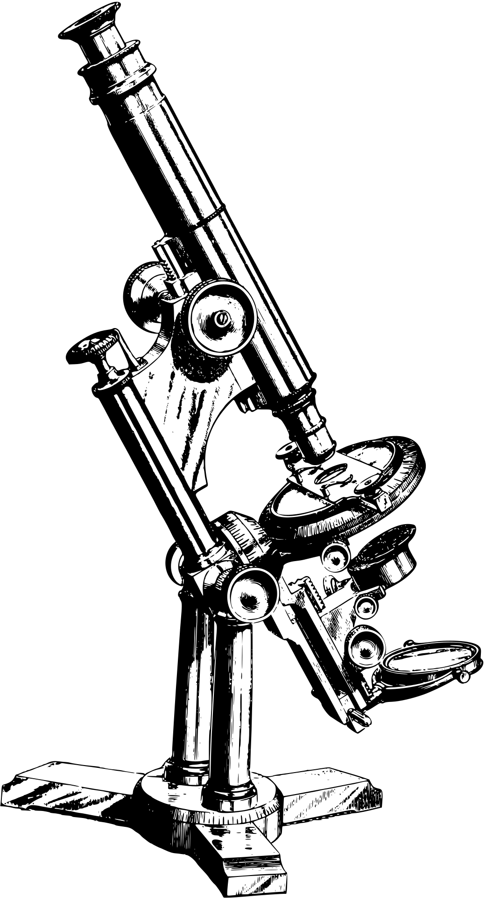

3. Differential Privacy Integration
Why Needed
Federated learning still leaks model gradients
Planned Additions
Noise injection into updates
Formal privacy guarantees
Outcome
Safer real-world hospital deployment
4. Improved Feature Engineering
Enhancements
ICD-9 → disease category grouping
Medication → drug-class grouping
Comorbidity indices (Charlson Index)
Benefit
More clinically meaningful features
Reduced noise in embeddings
5. Bias and Fairness Analysis
Future Evaluation
Performance across:
Age groups
Gender
Race
Goal
Detect and reduce algorithmic bias
Ensure ethical AI usage
6. Real-Time Clinical Decision Support System (CDSS)
Long-Term Vision
Integrate model into:
Hospital Information Systems
Discharge workflow
Capabilities
Real-time risk score
Automated alerts
Personalized follow-up plans

Slide 21







Summary
Current work is research-grade
Future work moves toward clinical deployment
Strong scope for publications and real-world impact

Slide 22



REFERENCES
Primary Dataset Reference
Strack, B., DeShazo, J. P., Gennings, C., et al.
Diabetes 130-US Hospitals Dataset (1999–2008).
Public clinical dataset widely reused in 2024–2025 diabetes readmission studies.
(Dataset source used in this work)
Research Papers Using the Same Dataset (2024–2025)
Zarghani, A. (2024)
Machine Learning-Based Prediction of 30-Day Readmission in Diabetic Patients Using the Diabetes 130-US Hospitals Dataset.
Department of Computer Engineering, Ferdowsi University of Mashhad, Iran.
Method: Centralized ML models (Logistic Regression, Random Forest, XGBoost)
imitation: No deep learning, no federated learning, no explainability
Gaso, M. S., Mekuria, R. R., Khan, A., Gulbarga, M. I., Tologonov, I., Sadriddin, Z. (2024)
Comparative Analysis of Machine Learning Algorithms for Diabetes Readmission Prediction.
Proceedings of CompSysTech 2024 – International Conference on Computer Systems and Technologies,
Ruse, Bulgaria, June 14–15, 2024.
Dataset: Diabetes 130-US Hospitals
Focus: Accuracy-based ML comparison
Limitation: No deep learning, no privacy-preserving methods

Slide 23


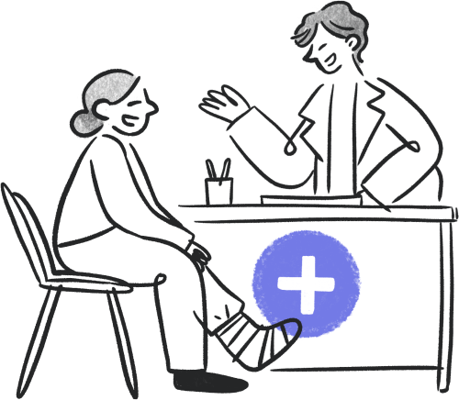



Liu, V. B., Sue, L. Y., Wu, Y. (2025)
Deep Learning Approach for Predicting Hospital Readmission in Diabetic Patients.
University of California, Los Angeles (UCLA), USA.
Method: LSTM-based centralized deep learning
Dataset: Diabetes 130-US Hospitals
Limitation: No federated learning, no explainable AI
Hameed, E. M., Joshi, H., Kadhim, Q. K. (2025)
Hybrid Machine Learning Models for Diabetes Readmission Risk Prediction.
Gujarat University, India; Middle Technical University, Iraq; University of Diyala, Iraq.
Dataset: Diabetes 130-US Hospitals
Focus: ML–DL accuracy comparison
Limitation: No federated learning, no explainability
Supporting Studies (2024–2025)
Recent Federated Learning Studies in Healthcare (2024–2025)
Federated learning for privacy-preserving clinical prediction.
Observation: Limited application to diabetes tabular datasets.
Recent Explainable AI Studies (2024–2025)
SHAP and LIME for interpretable clinical risk prediction.
Observation: Mostly applied to centralized ML/DL models.

Slide 24

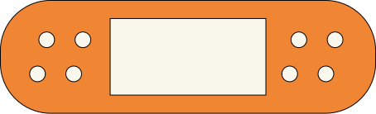


Slide 25



Future Enhancements
Integrate Clinical Notes (ClinicalBERT/BioBERT).
Multimodal fusion of structured + unstructured data.
Causal inference for modifiable risk factors.
Real-time risk updates.

Slide 26




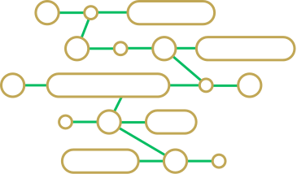
DATA COLLECTION AND DATATYPE
DATASET OVERVIEW:
Name: Diabetes 130-US Hospitals
Source: UCI Machine Learning Repository
Type: Structured tabular Electronic Health Records (EHR)
Size: ~101,766 patient encounters from ~130 hospitals (1999–2008)
Target Label: Readmission within 30 days (<30 days, >30 days, No readmission)
DATA FIELDS:
Demographics: Age, Gender, Race
Admission Details: Admission type/source, Discharge disposition
Clinical Utilization: Time in hospital, number of inpatient/emergency/outpatient visits
Lab and Procedures: Lab tests, procedures performed, medications administered
Diagnosis & Medication Information: ICD-9 diagnosis groups, medication change flags
DATA TYPES:
Categorical: Race, Gender, Admission type, Discharge disposition, Diagnosis codes, Medications
Numerical: Time in hospital, Number of diagnoses, Lab procedures, Number of medications
DATA PREPROCESSING STEPS:
Handling Missing Values: Impute or remove missing data to ensure dataset completeness
Encoding Categorical Features: Label encoding or one-hot encoding for non-numerical attributes
Scaling Numerical Features: Standardization to normalize features for model training
Sequence Construction: Grouping patient visits chronologically to capture temporal patterns

Slide 27

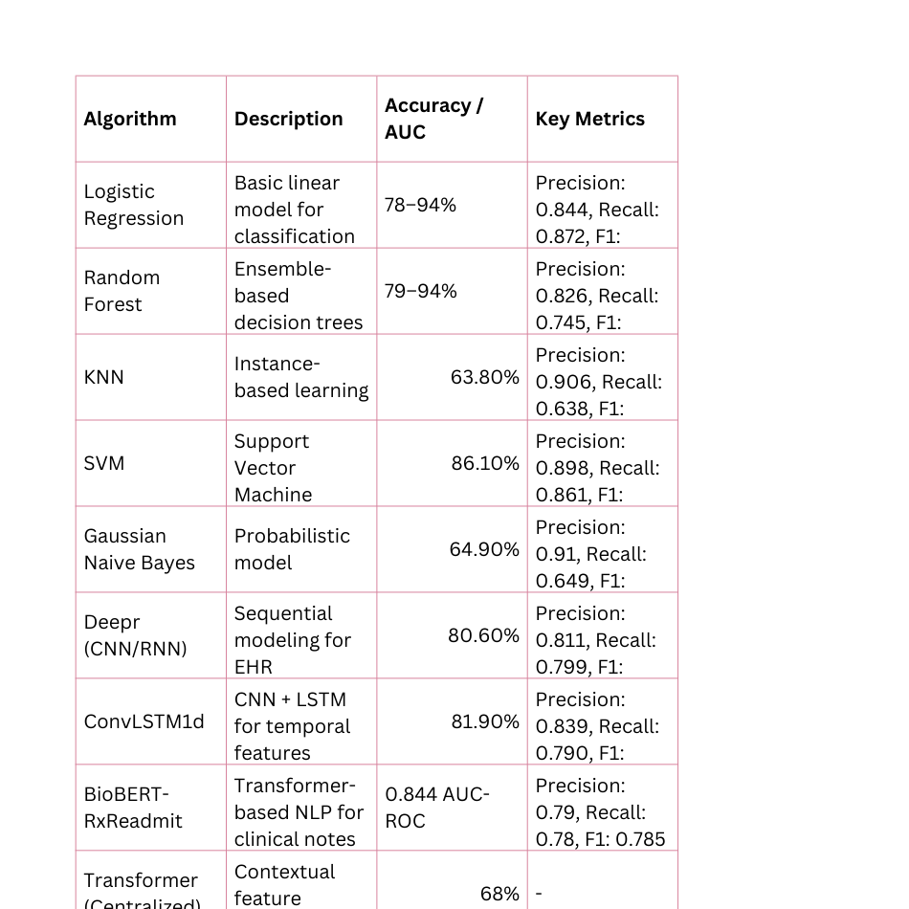


REPORTED ALGORITHMS USED AND THEIR ACCURACY
Several machine learning and deep learning approaches have been applied for predicting 30-day and 180-day hospital readmissions. Their performance
varies based on dataset type, feature selection, and model architecture.
INSIGHTS
Classical ML models (Logistic Regression, Random Forest) perform well on structured features.
Deep learning models (Deepr, ConvLSTM1d) capture temporal patterns and improve recall for high-risk patients.
Transformer-based models, especially BioBERT-RxReadmit, leverage textual EHR data for superior AUC.
Federated learning frameworks (MultiProg, Federated Transformer) enable privacy-preserving training with competitive accuracy.

Slide 28




Literature Review

Slide 29

Title: An Interpretable Deep-Learning Framework for Predicting Hospital Readmissions from Electronic Health Records
Authors: Fabio Azzalini, Tommaso Dolci, Marco Vagaggini (2025)
Dataset: MIMIC-III ICU EHR (public, de-identified)
Features: ICD-9-CM diagnosis/procedure codes, time gap between admissions
Methodology:
Word2Vec embeddings (300-d) for codes.
ConvLSTM1d for spatial-temporal patterns.
LSTM for time-gap sequences.
Concatenate both branches → Dense layers → Probability output.
Key Findings:
Outperformed Deepr, logistic regression, random forest.
Identified invasive procedures, cardiovascular/hepatic diseases, cancers, neurological disorders as top predictors.
Limitations:
Excludes labs, medications, clinical notes.
Evaluated only on ICU patients.
Interpretability method is model-specific.

Slide 30

TITLE: ENHANCING READMISSION PREDICTION WITH DEEP LEARNING: EXTRACTING BIOMEDICAL CONCEPTS FROM CLINICAL TEXTS
Authors: Rasoul Samani, Mohammad Dehghani, Fahime Shahrokh (2024)
Dataset: MIMIC-III v1.4 discharge summaries (public)
Features: Only unstructured discharge summary text
Methodology:
Preprocess text (cleaning, lemmatization, stopword removal).
BDSS (Bio-Discharge Summary BERT) for contextual embeddings.
PCA to reduce embeddings (3072 → 50).
MLP classifier for prediction.
Key Findings:
Accuracy: 94%, Recall: 0.94, F1: 0.911, AUC: 0.75.
High recall → effective at identifying high-risk patients.
Shows clinical notes alone can be sufficient.
Limitations:
Dataset imbalance (~6% readmissions) not addressed.
No structured variables included.
Input length capped → possible info loss.

Slide 31

TITLE: PRIVACY-PRESERVING FEDERATED LEARNING FRAMEWORK FOR MULTI-SOURCE ELECTRONIC HEALTH RECORDS PROGNOSIS PREDICTION
Authors: Huiya Zhao, Dehao Sui, Yasha Wang, Liantao Ma, Ling Wang (2025)
Dataset: CDSL (Spain COVID-19 EHR), ESRD (peritoneal dialysis), TJH (hospital data) – private
Features: Time-series labs (albumin, urea, hemoglobin, WBC, potassium, etc.), vitals, demographics
Methodology:
Multi-channel GRU embedding per feature.
Federated Learning (FedAvg) for model aggregation.
Attention-based feature recalibration.
Task-specific layers for mortality, LOS.
Key Findings:
AUPRC (TJH): 99.70%, AUROC (CDSL): 97.89%.
Improves privacy, handles heterogeneity.
Limitations:
Vulnerable to membership inference in extreme heterogeneity.
Basic missing data handling (mean/mode).
Cross-border legal issues.

Slide 32

Title: BioBERT-RxReadmit: Improving Hospital Readmission Predictions Through Clinical Text Analysis with BioBERT
Authors: Akshi Kumar, Jyothi Malla, Aditi Sharma (2025)
Dataset: MIMIC-III clinical notes (public)
Features: Extracted entities (symptoms, medications, diagnoses) + raw text embeddings
Methodology:
Stage 1: NER with BioBERT to extract clinical entities.
Stage 2: Classification using concatenated raw text + NER features.
Attention mechanism for feature weighting.
Key Findings:
AUC-ROC: 0.844 (better than BERT baseline: 0.48, DeepNote-GNN: 0.79).
Highlights high-risk terms like “heart failure,” “medication non-adherence.”
Limitations:
Domain-specific; performance may drop in other settings.
Dependent on note quality and labeling.
Computationally heavy.

Slide 33

TITLE: TRANSFORMER-BASED PREDICTION OF HOSPITAL READMISSIONS FOR DIABETES PATIENTS
AUTHORS: JORGE GARCÍA-MOSQUERA, MARÍA VILLA-MONEDERO, MANUEL GIL-MARTÍN, RUBÉN SAN-SEGUNDO (2025)
Dataset: US Health Facts Diabetes dataset (101,766 patients) – public
Features: Demographics, prior visits, discharge disposition, HbA1c levels, diagnoses, medications
Methodology:
Structured data tokenized like words in a sentence.
Multi-head attention for feature weighting.
Random Forest + permutation tests for feature selection.
Binary and multiclass classification tasks.
Key Findings:
Binary accuracy: 65.82%, AUC: 0.657 (better than SVM, RF).
HbA1c, discharge disposition, and prior inpatient visits are top predictors.
Limitations:
Data imbalance handled by under-sampling (may bias results).
Transformers less interpretable.
Requires GPU for efficient training.

Slide 34


THANK
YOU
presented by,
VISHNU DHATHAN,
YASWANTH,
YOGESWARAN.

